Slide 1
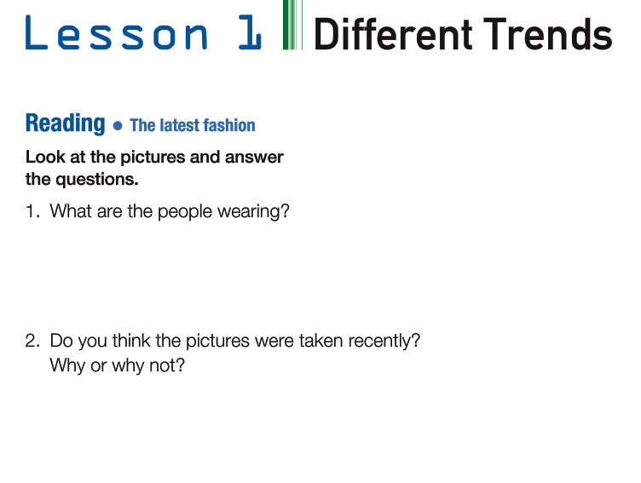
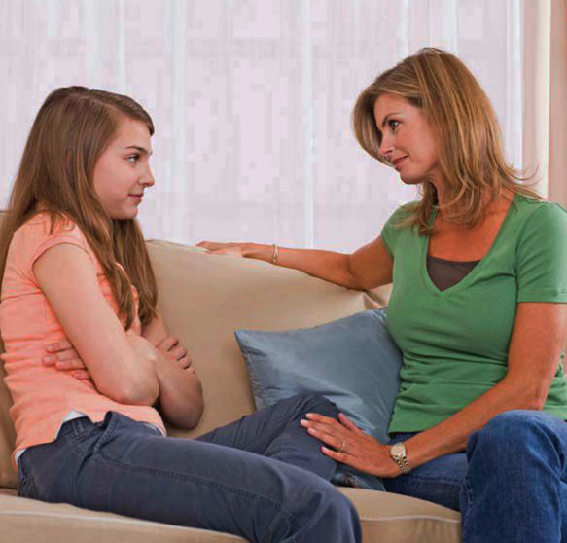
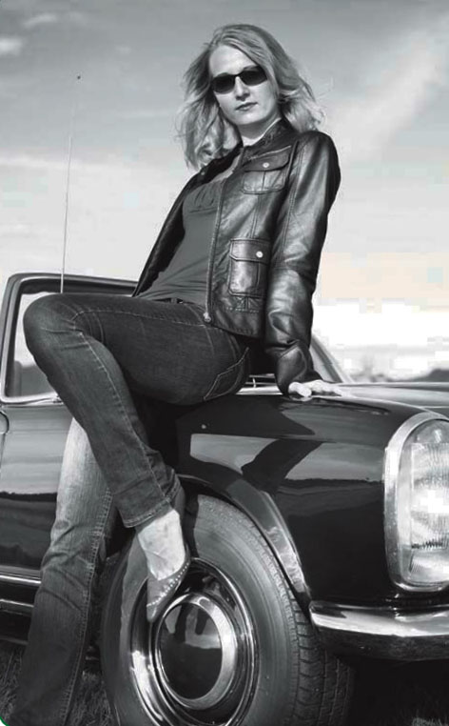
The mom is wearing a green t-shirt and jeans, and the daughter is wearing a pink t-shirt and jeans.
The first picture was taken recently because it’s a full colored picture and the second one not, because it’s a black and white picture.

Slide 2
Vocabulary:
9) Short skirts:
10) Tight jeans:
11) Tight t-shirts:
12) Leather jacket:
13) Shoes:
14) High heels:
15) Teenager:
16) Flat shoes:
Fashion:
Clothes:
Magazines:
Shopping:
Enough:
Pictures:
Funny:
Long skirts:
Faldas cortas
moda
ropa
Jeans ajustados
revistas
Poleras ajustadas
compras
Chaqueta de cuero
suficiente
zapatos
fotos
Tacones altos
divertido
adolescente
Faldas largas
Zapatos bajos

Slide 3
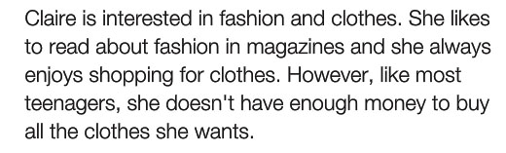

Slide 4
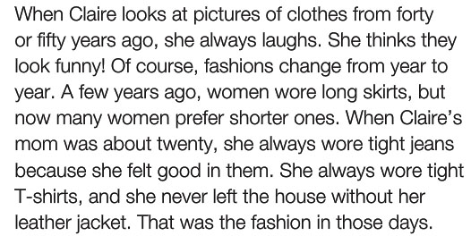

Slide 5
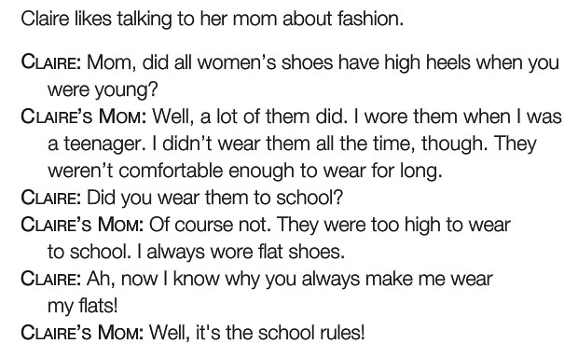

Slide 6
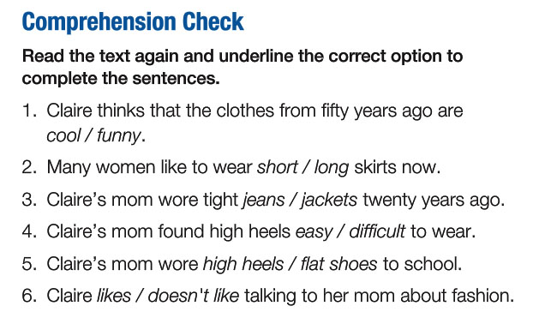

Slide 7
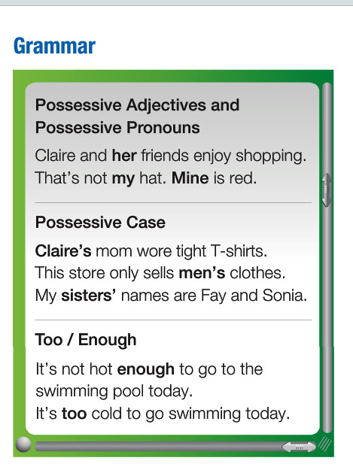
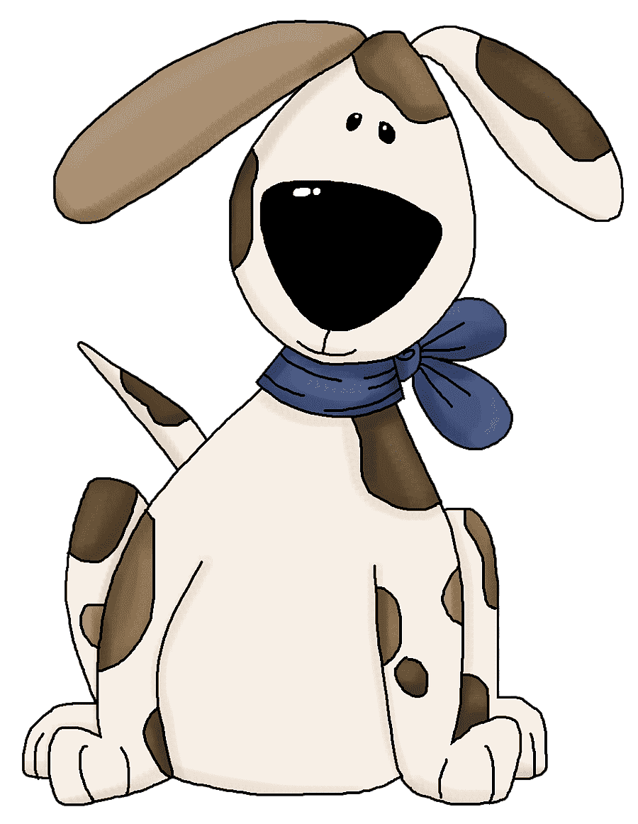

Slide 8




This is Sally’s house
Whose cat is that? It’s Kate’s.
It’s too early to have lunch.
John isn’t old enough to drive a car. (He’s 5 years old)

Slide 9
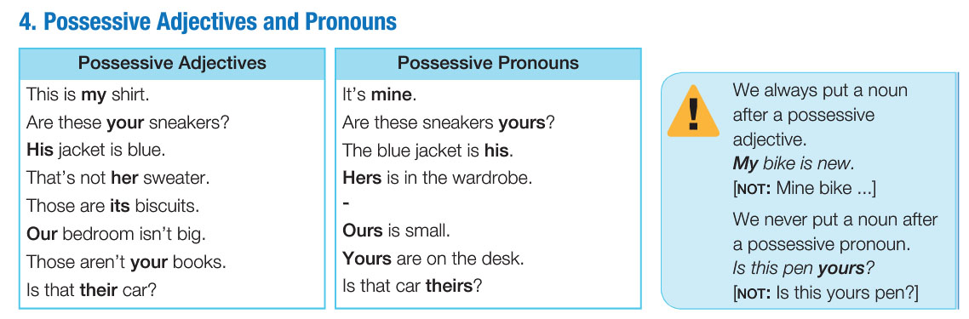
Sally: This is my house.
Sally: This house is mine.

Slide 10
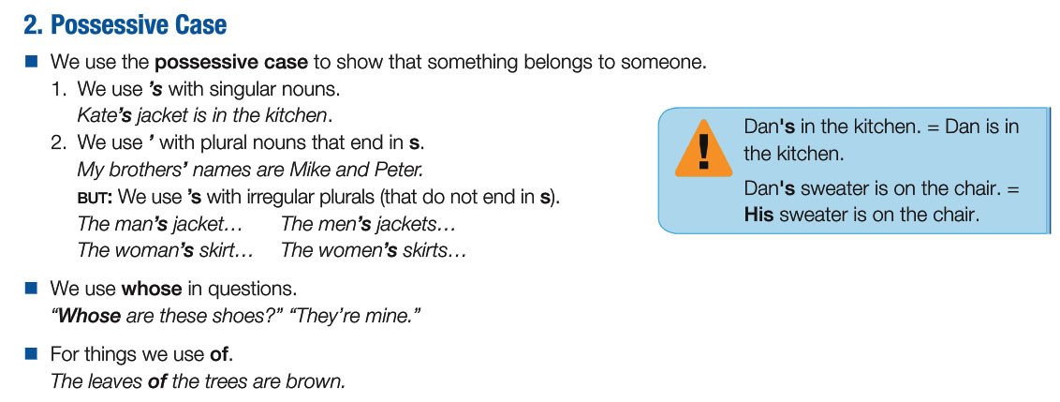
Whose cat is that? It’s Kate’s.

Slide 11
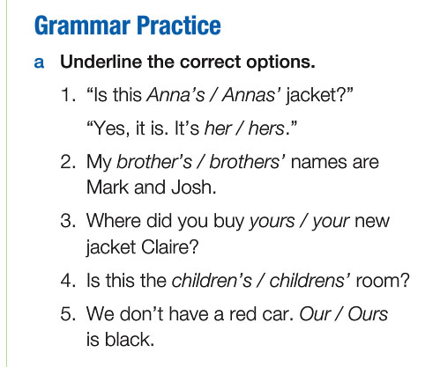
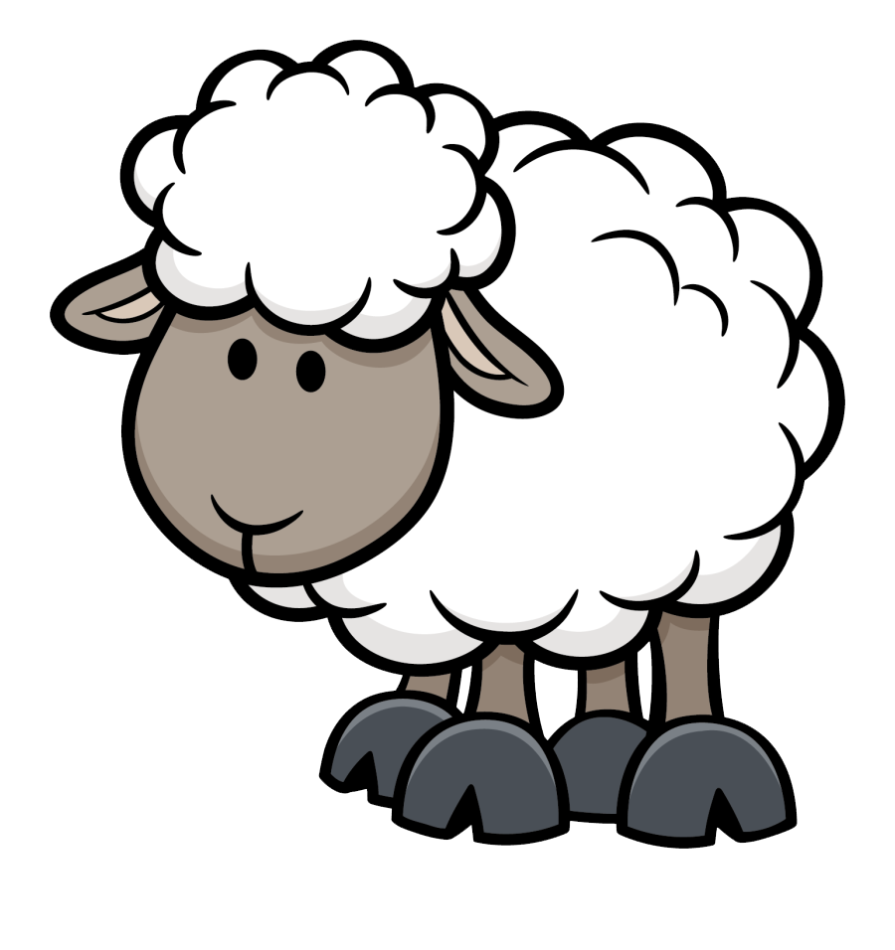

Slide 12
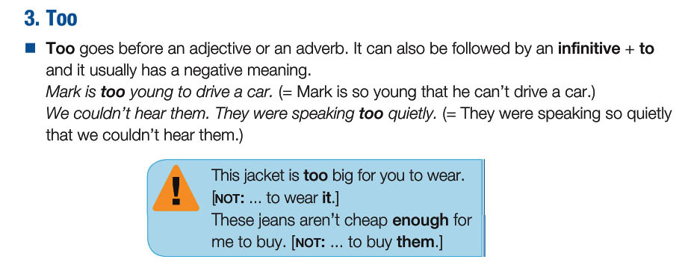
It’s too early to have lunch.

Slide 13
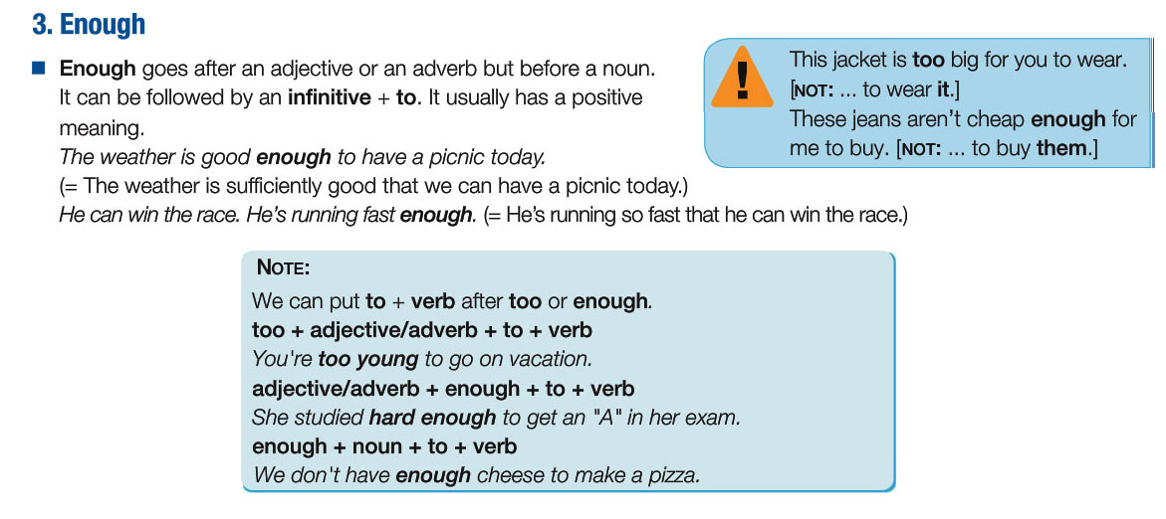
John isn’t old enough to drive a car. (He’s 5 years old)

Slide 14
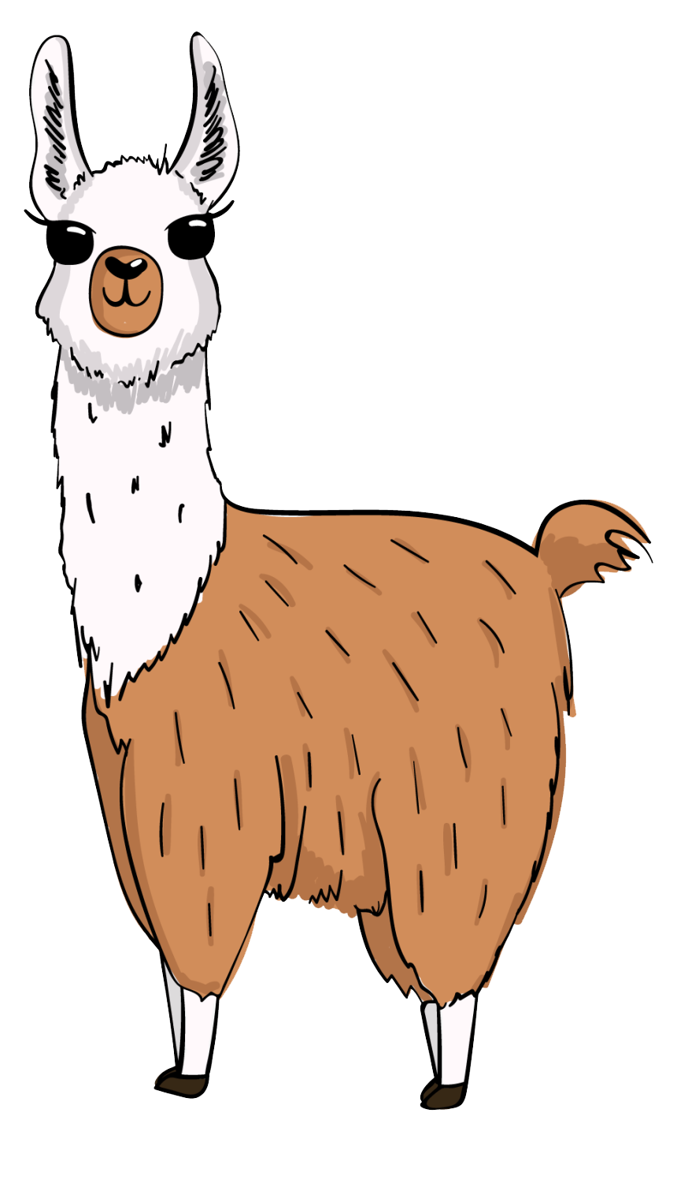
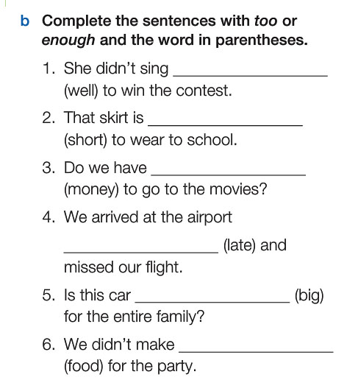

Slide 15
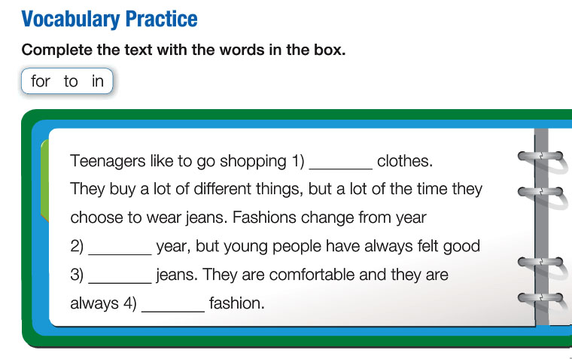

Slide 16
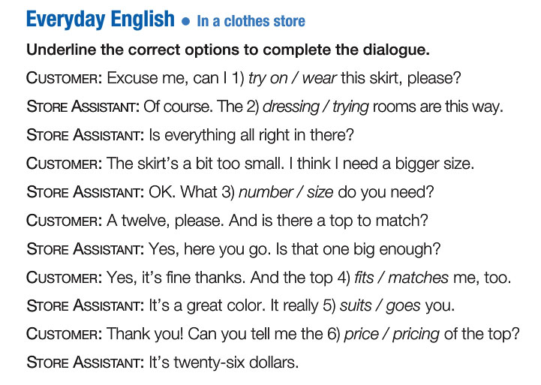

Slide 17
