Slide 1
Unit 1: Different People
Objective : Recognice the basic part of the the english gramar, like verb to be and verb to have.
Vocabulary: Pars of the body, numbers, days of the week month and seasons, nationalities, relatives

Slide 2
Ver to be / dos significados en español SER y ESTAR.
Be: forms
Be is an irregular verb with several forms
Present: (I) am,
(he, she, it) is
(you, we, they) are

Slide 3
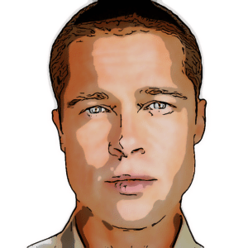
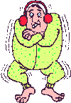
1. To say who we are
Brad Pitt is an actor
2. To talk about the weather
It is very cold today

Slide 4
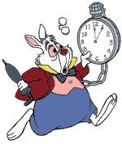
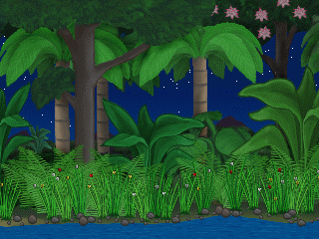
3. To talk about time
What time is it?
4. To talk about place
The Amazon River isn’t in Canada

Slide 5
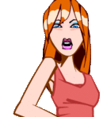
5. To talk about how we feel
She is angry
6. To talk about people’s age
I’m 44 years old

Slide 6
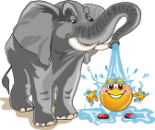
7. To say hello
How are you?
8. To describe things
Elephants aren’t small

Slide 7
AFFIRMATIVE
I
She
am
I’m
is
She’s
You
are
You’re
It
is
It’s
He
is
He’s

Slide 8
AFFIRMATIVE
We
You
are
We’re
are
You’re
They
are
They’re

Slide 9
negaTIVE
I
She
am
not
is
not
You
are
not
It
is
not
He
is
not

Slide 10
negATIVE
We
You
are
not
are
not
They
are
not

Slide 11
interrogative
I
Am
Is
she
you
Are
it
Is
he
Is

Slide 12
interrogative
Are
we
you
Are
they
Are

